Slide 1
Wire Sculpture

Slide 2
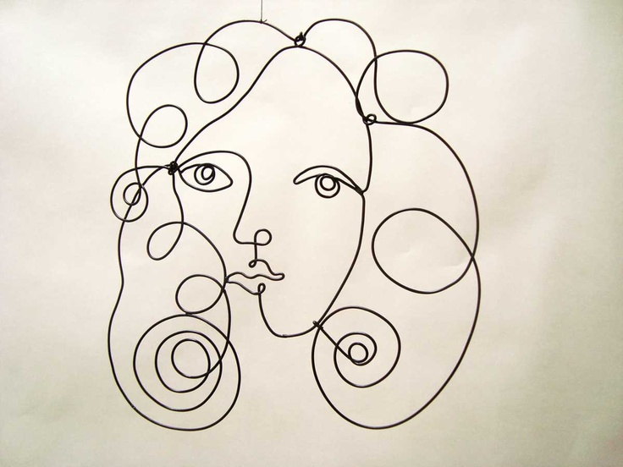

Slide 3
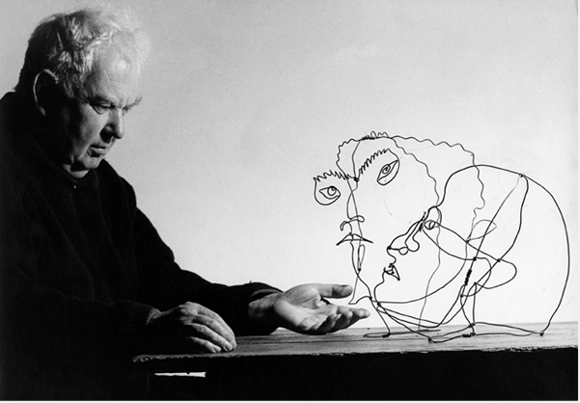

Slide 4
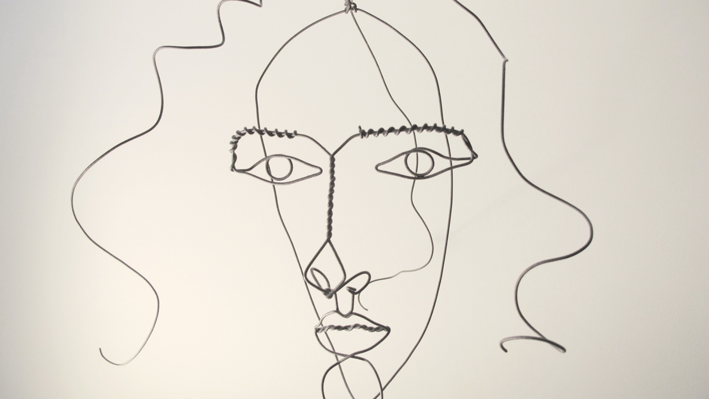

Slide 5
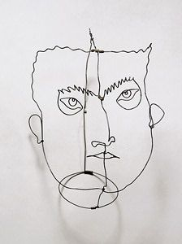

Slide 6
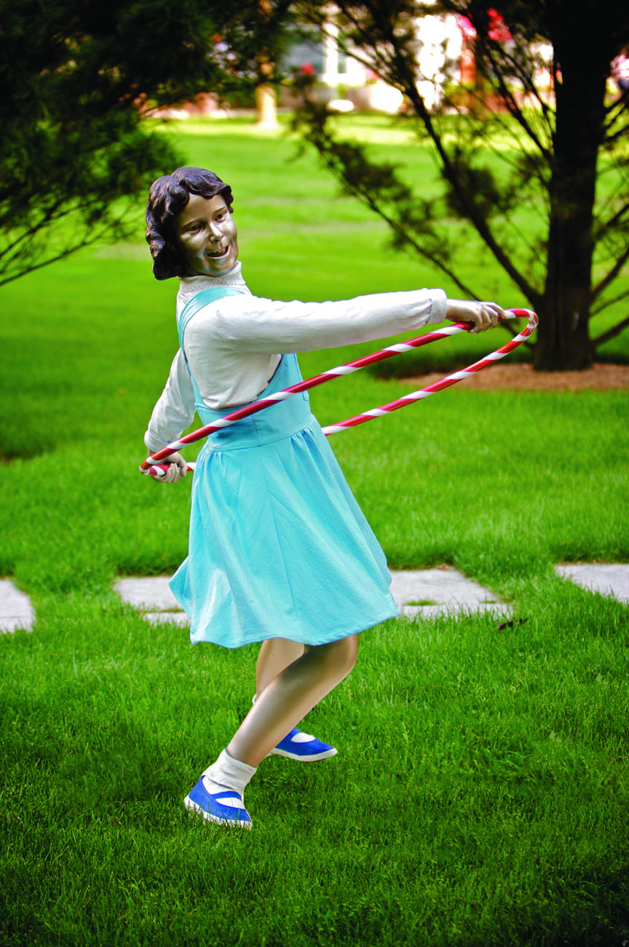
Attic Trophy by Seward Johnson © 1992 The Seward Johnson Atelier, Inc. – Photo by David W. Steele

Slide 7
Contact by Seward Johnson © 1987 The Seward Johnson Atelier, Inc. – Photo by Carl Deal III

Slide 8
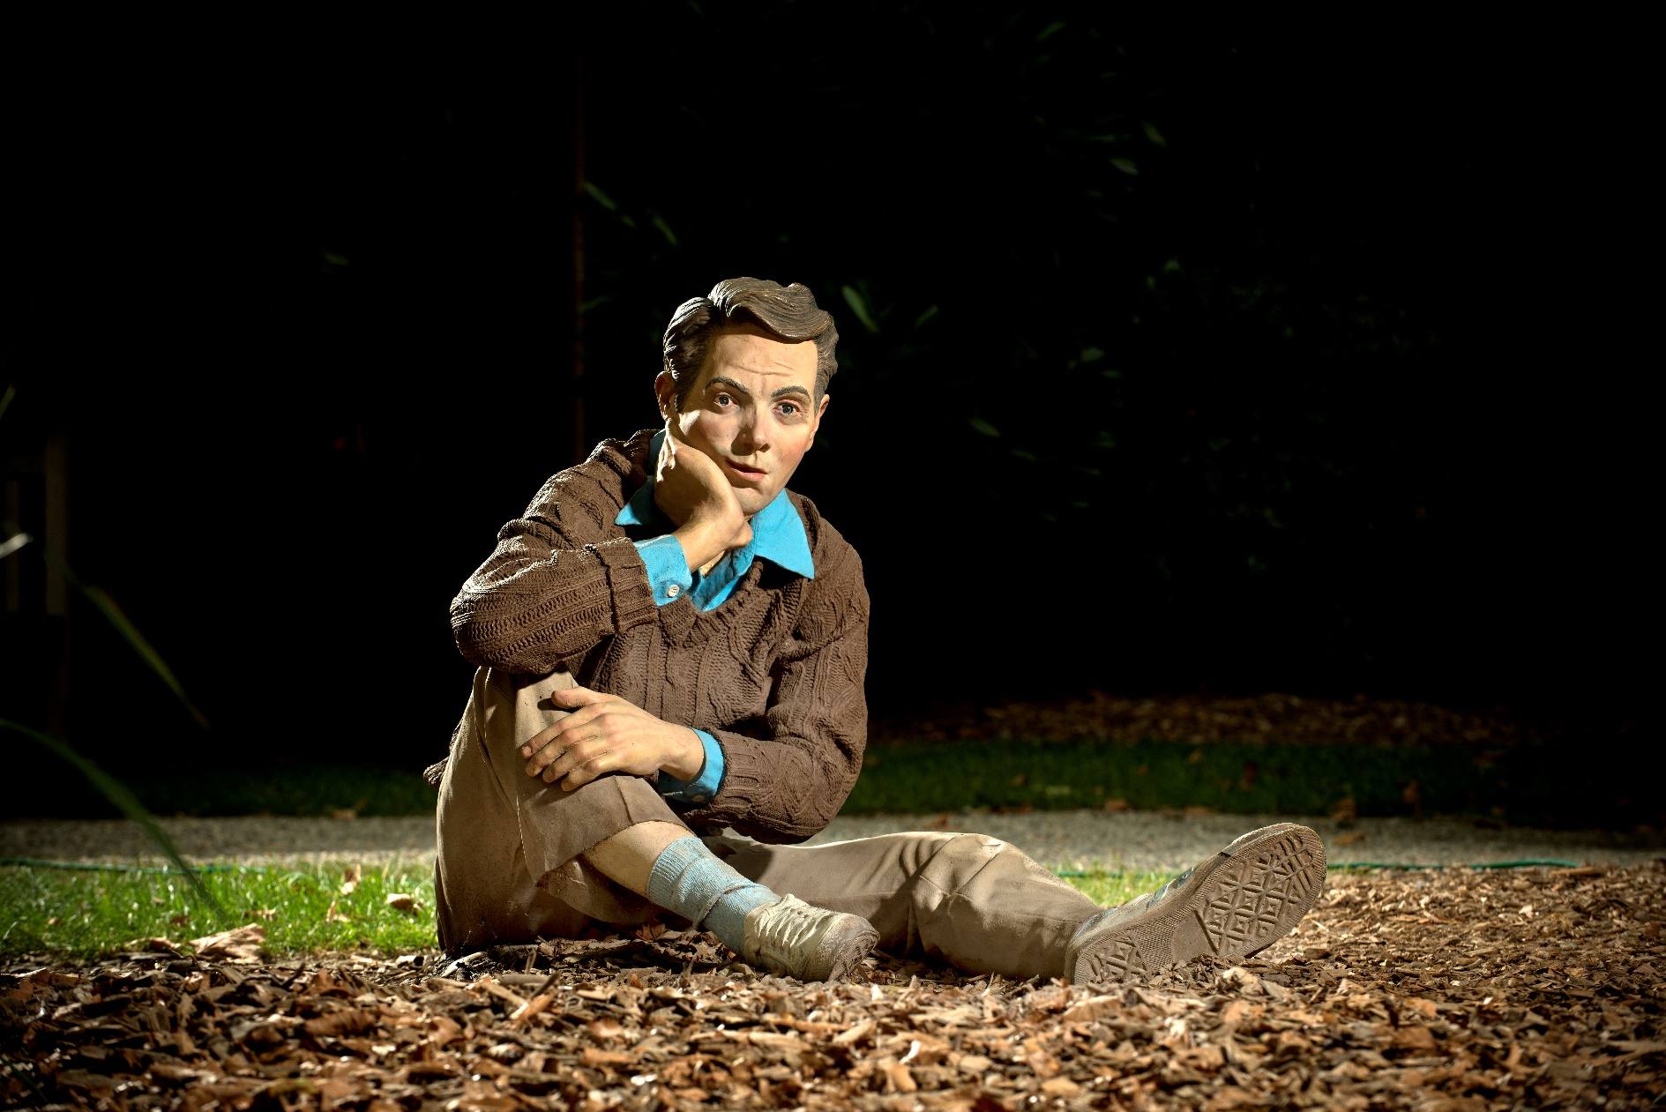
Far Out by Seward Johnson © 1979 The Seward Johnson Atelier, Inc. – Photo by Kenny Ek

Slide 9
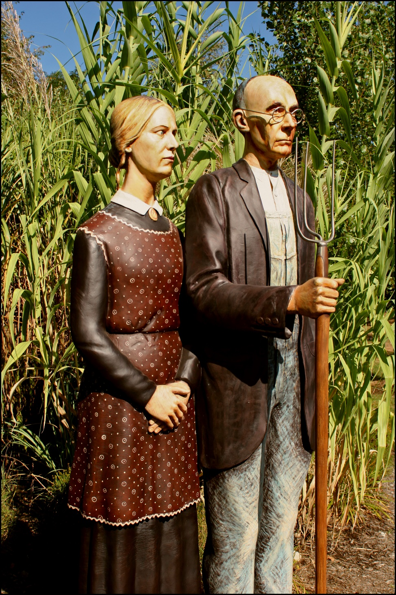
God Bless America by Seward Johnson © 2005 The Seward Johnson Atelier, Inc.

Slide 10
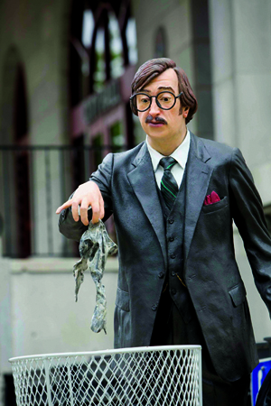
Holier Than Thou by Seward Johnson © 1984 The Seward Johnson Atelier, Inc.

Slide 11
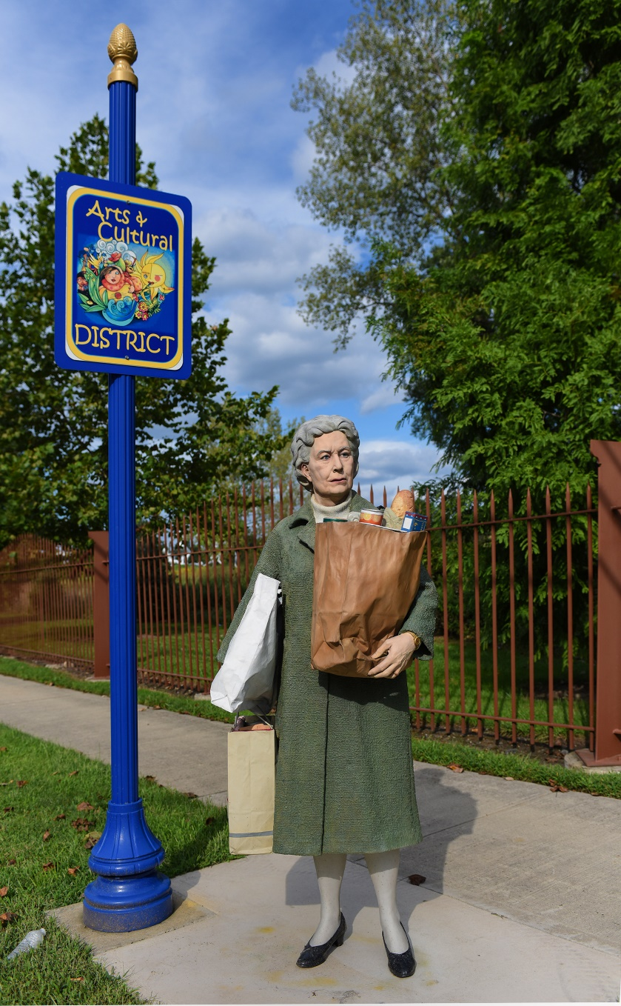
Holding Out by Seward Johnson © 1987 The Seward Johnson Atelier, Inc.

Slide 12
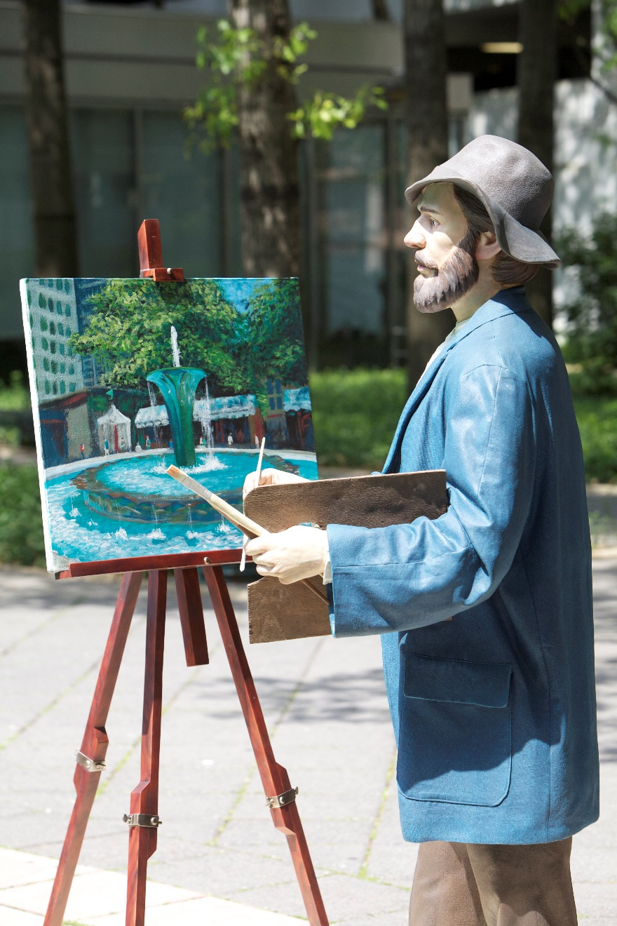
Monet, Our Visiting Artist by Seward Johnson © 2004 The Seward Johnson Atelier, Inc. - Photo by Carl Deal III

Slide 13
No, Mommy, That One by Seward Johnson © 1992 The Seward Johnson Atelier, Inc. - Photo by David W. Steele

Slide 14
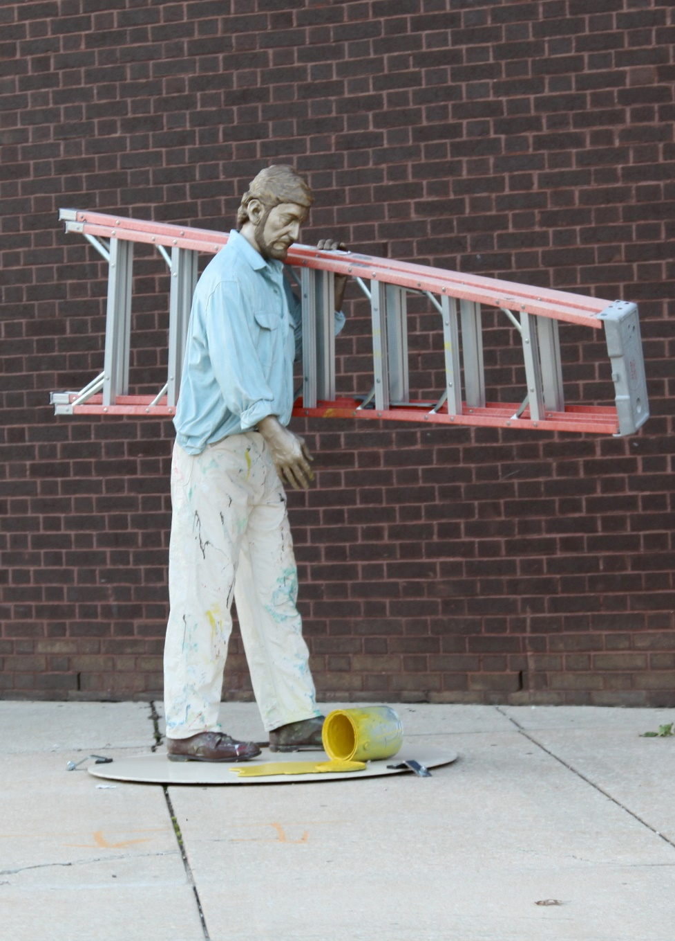
Oops by Seward Johnson © 1994 The Seward Johnson Atelier, Inc.

Slide 15
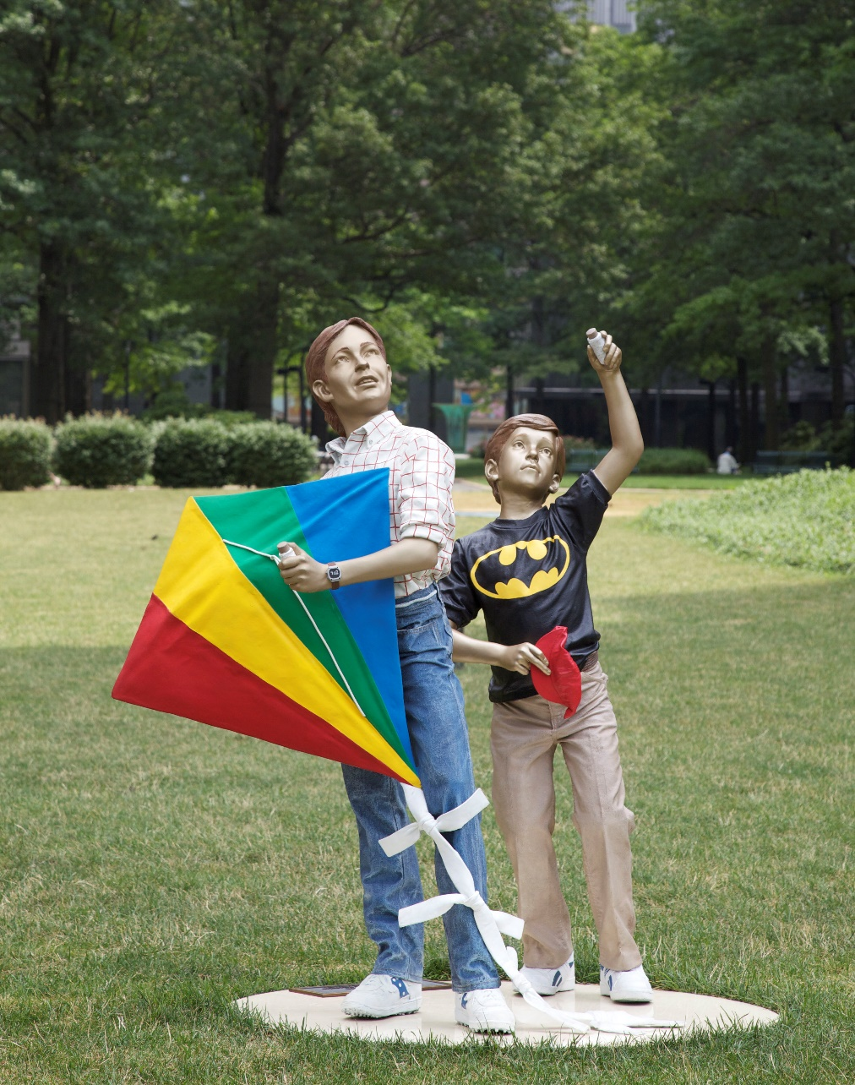
Out of Sight by Seward Johnson © 1991 The Seward Johnson Atelier, Inc.

Slide 16
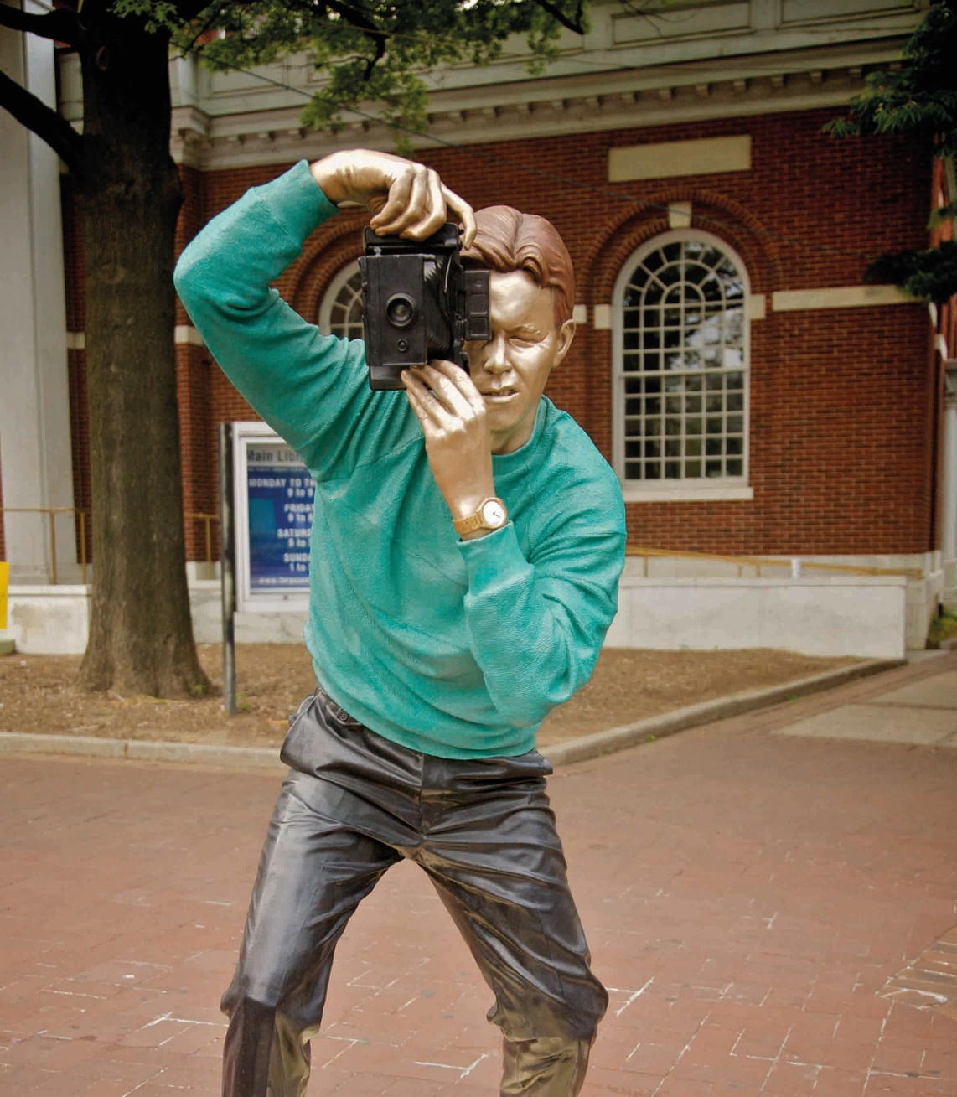
Sightseeing by Seward Johnson © 1987 The Seward Johnson Atelier, Inc.

Slide 17
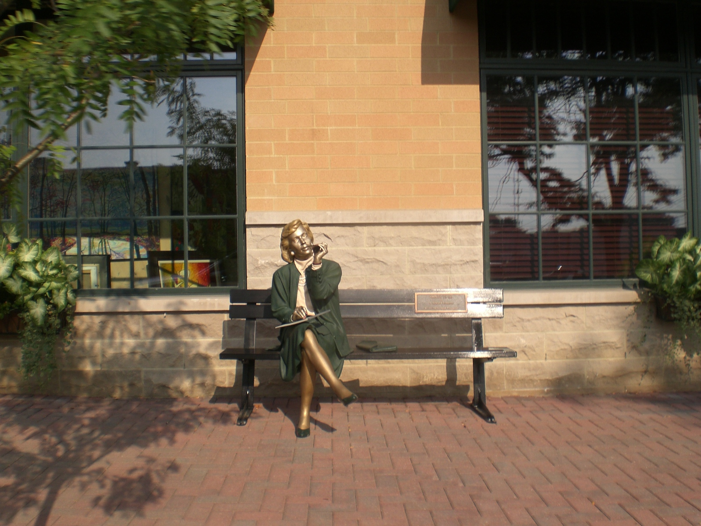
Things to Do by Seward Johnson © 1992 The Seward Johnson Atelier, Inc.

Slide 18
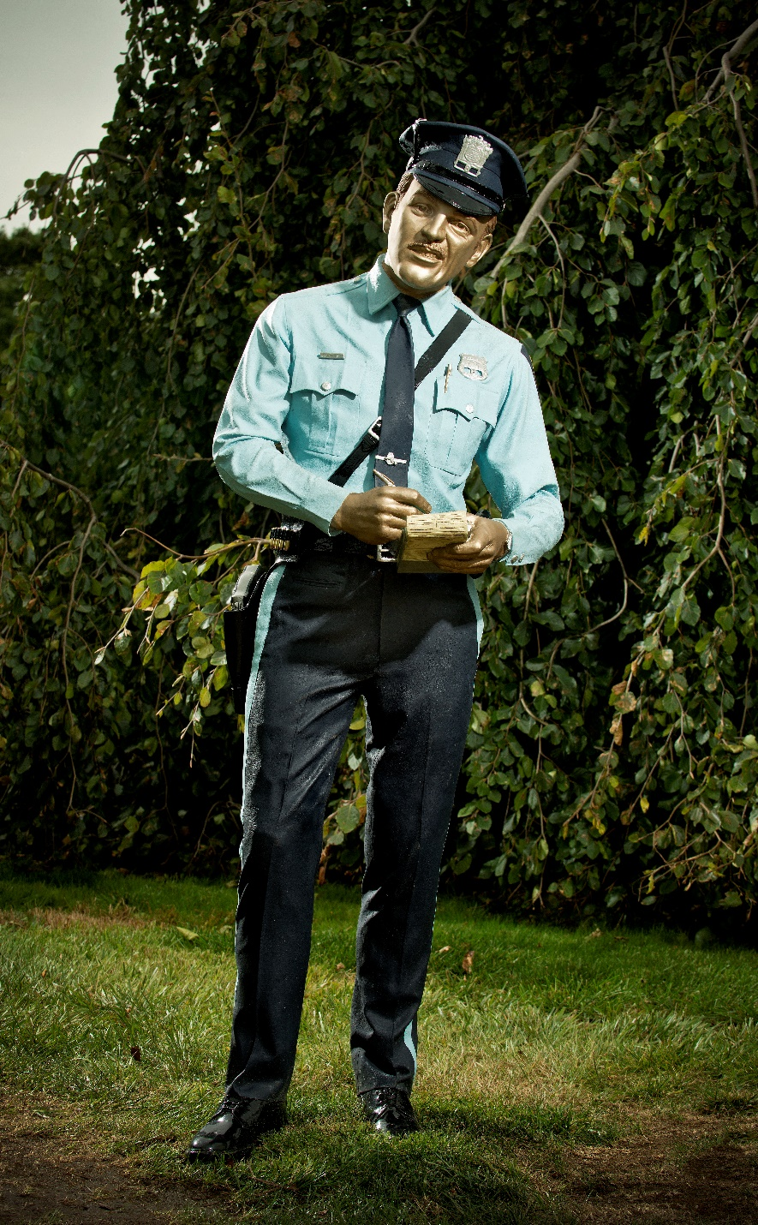
Time’s Up by Seward Johnson © 1983 The Seward Johnson Atelier, Inc. - Photo by Kenny Ek

Slide 19
Hot Weather by Seward Johnson © 1981 The Seward Johnson Atelier, Inc.

