Slide 1
Gesture Drawing

Slide 2
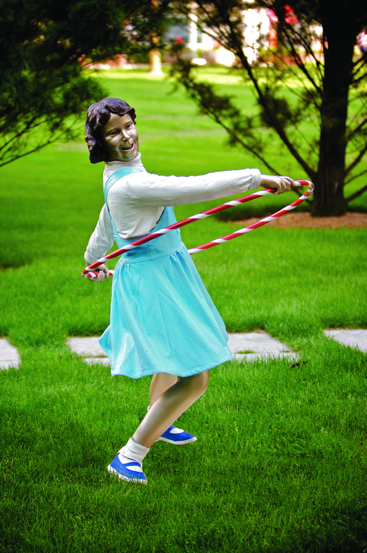
Attic Trophy by Seward Johnson © 1992 The Seward Johnson Atelier, Inc. – Photo by David W. Steele

Slide 3
Contact by Seward Johnson © 1987 The Seward Johnson Atelier, Inc. – Photo by Carl Deal III

Slide 4
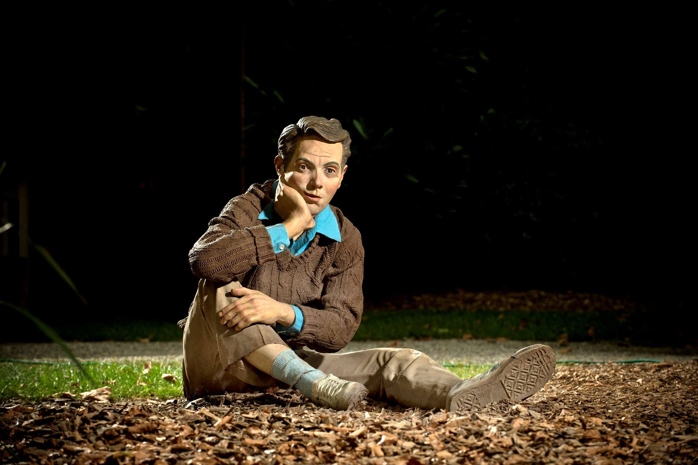
Far Out by Seward Johnson © 1979 The Seward Johnson Atelier, Inc. – Photo by Kenny Ek

Slide 5
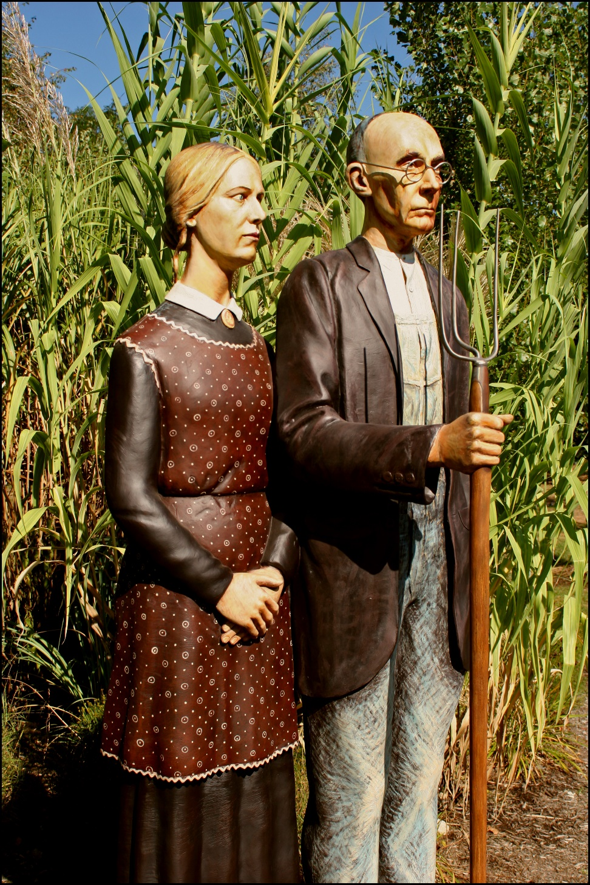
God Bless America by Seward Johnson © 2005 The Seward Johnson Atelier, Inc.

Slide 6
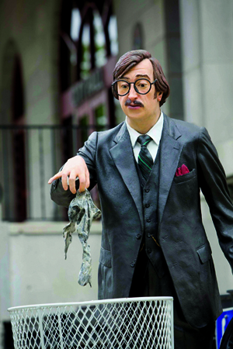
Holier Than Thou by Seward Johnson © 1984 The Seward Johnson Atelier, Inc.

Slide 7
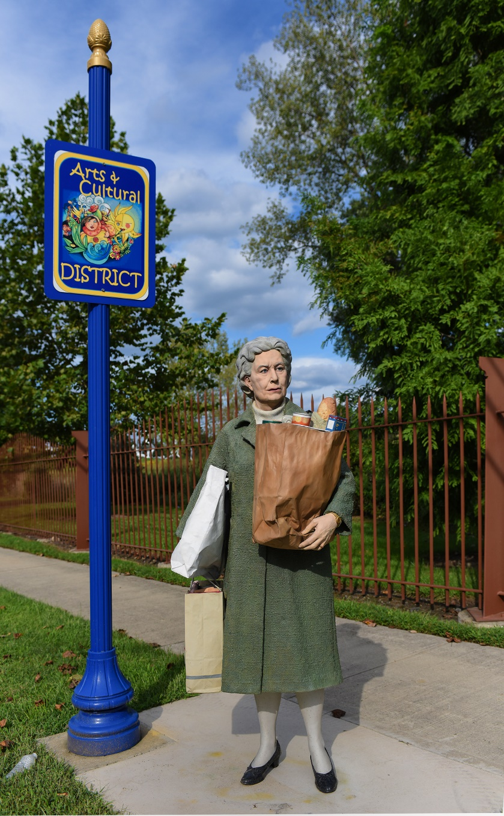
Holding Out by Seward Johnson © 1987 The Seward Johnson Atelier, Inc.

Slide 8
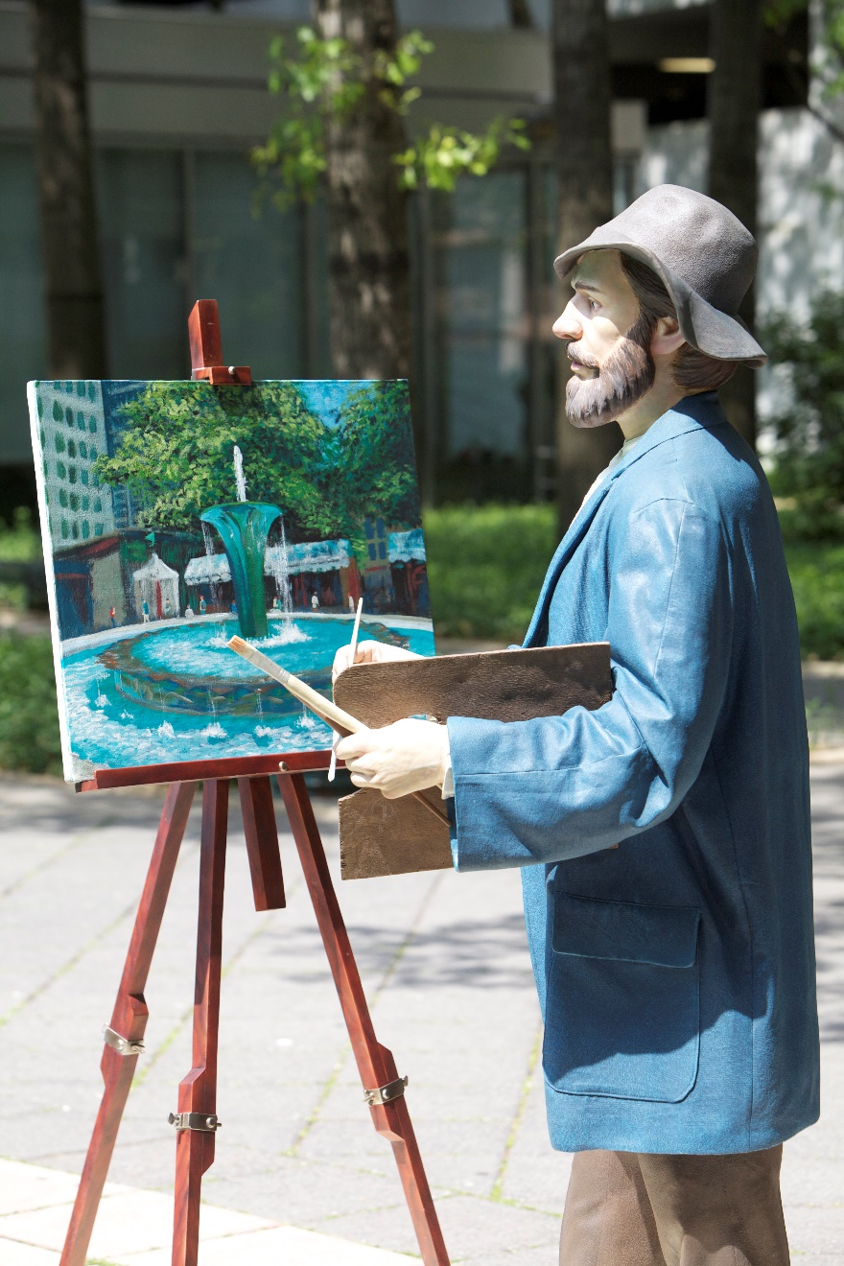
Monet, Our Visiting Artist by Seward Johnson © 2004 The Seward Johnson Atelier, Inc. - Photo by Carl Deal III

Slide 9
No, Mommy, That One by Seward Johnson © 1992 The Seward Johnson Atelier, Inc. - Photo by David W. Steele

Slide 10
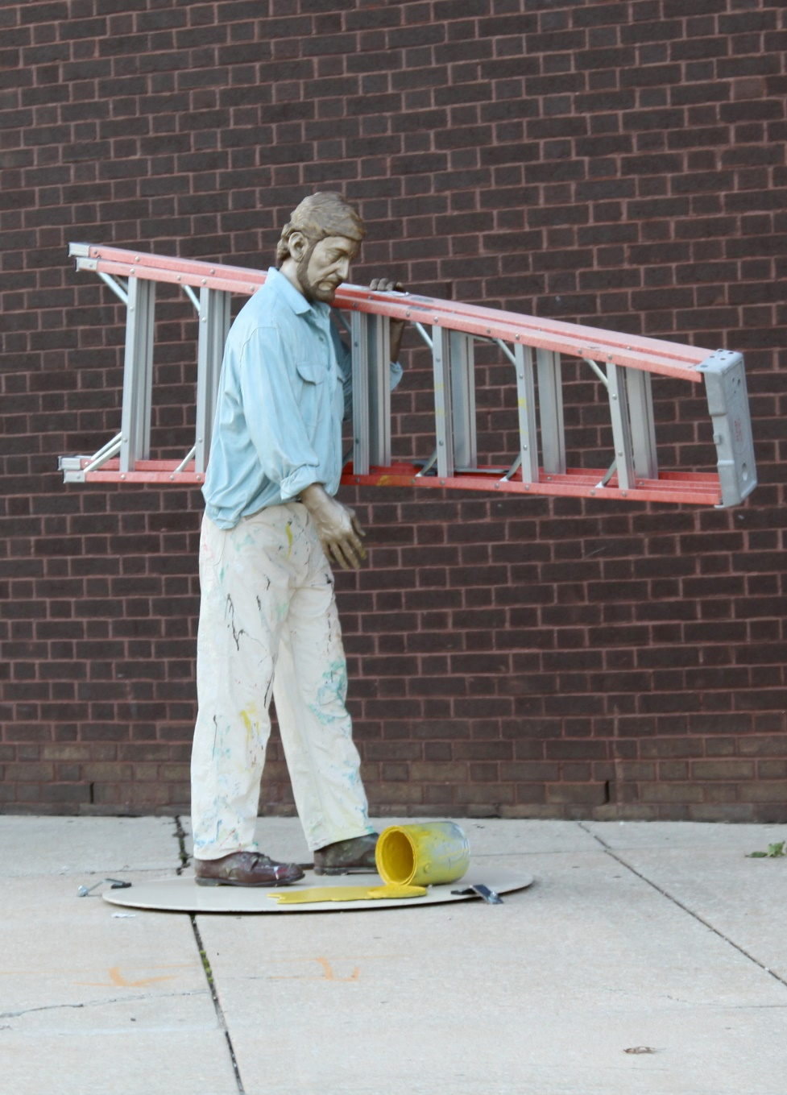
Oops by Seward Johnson © 1994 The Seward Johnson Atelier, Inc.

Slide 11
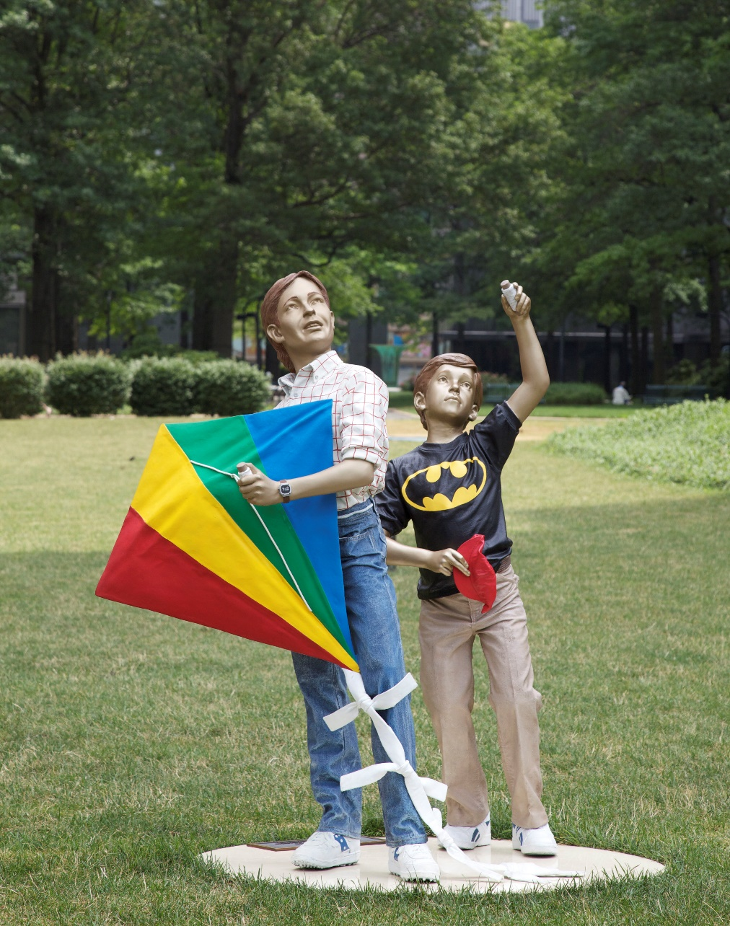
Out of Sight by Seward Johnson © 1991 The Seward Johnson Atelier, Inc.

Slide 12
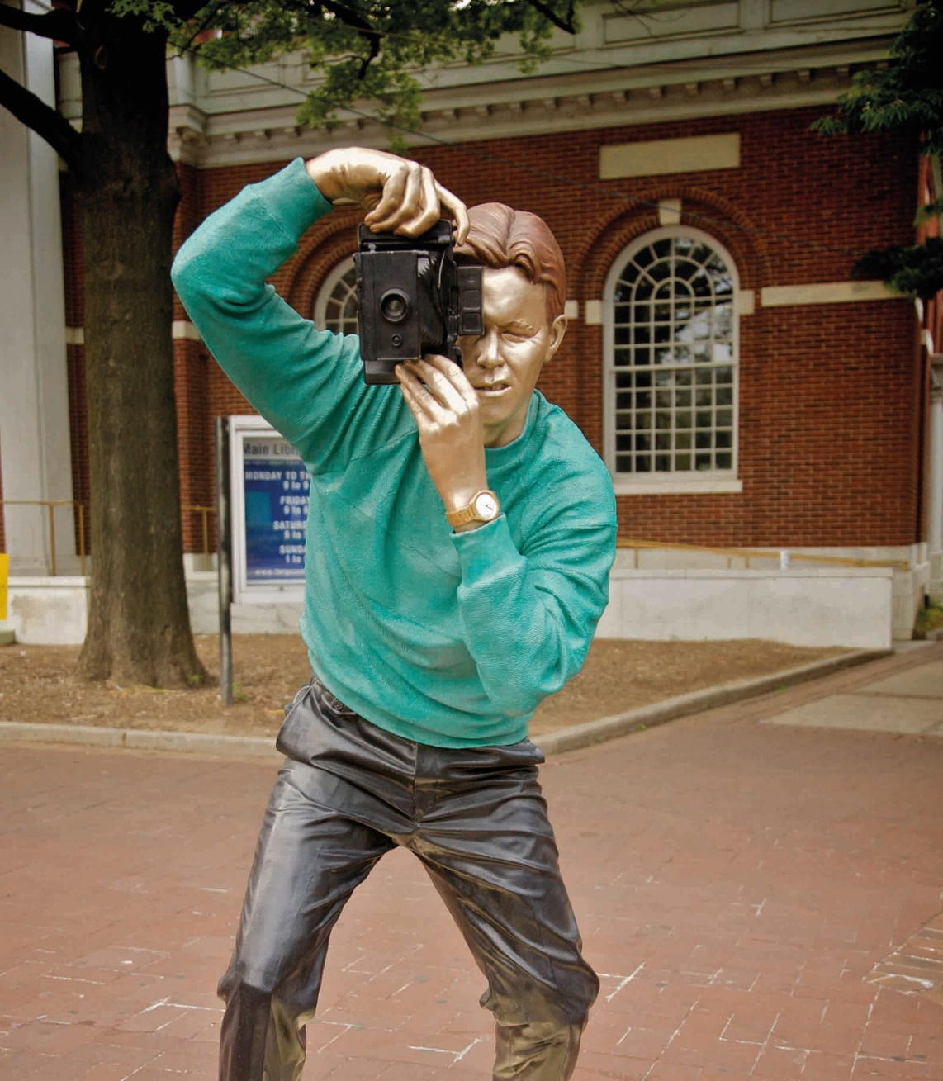
Sightseeing by Seward Johnson © 1987 The Seward Johnson Atelier, Inc.

Slide 13
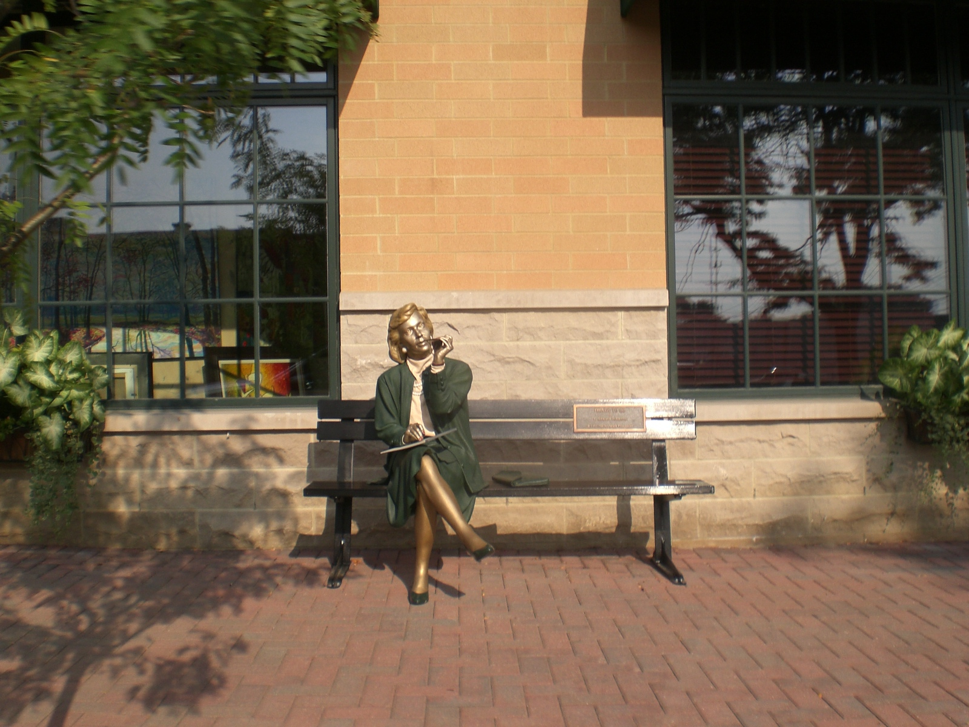
Things to Do by Seward Johnson © 1992 The Seward Johnson Atelier, Inc.

Slide 14
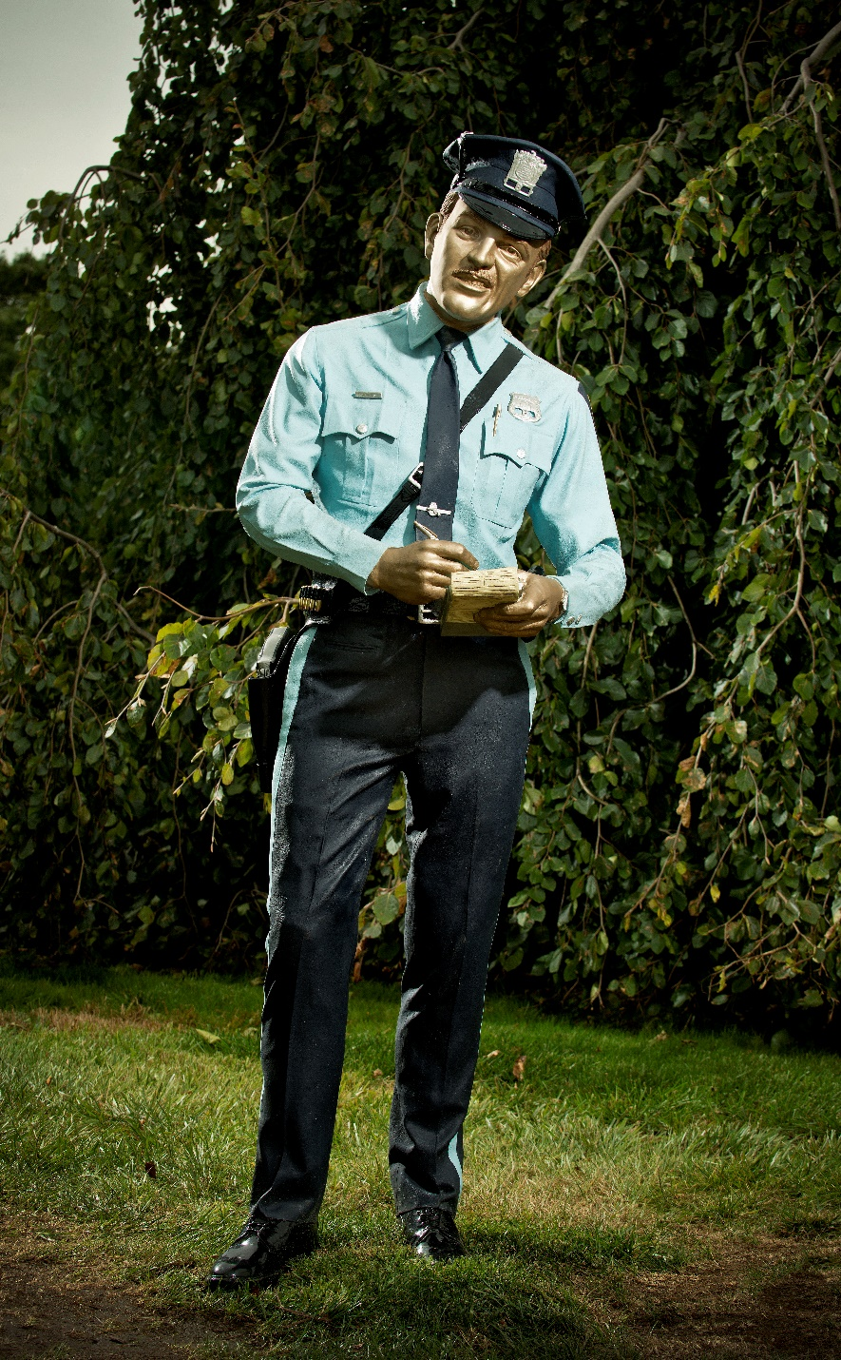
Time’s Up by Seward Johnson © 1983 The Seward Johnson Atelier, Inc. - Photo by Kenny Ek

Slide 15
Hot Weather by Seward Johnson © 1981 The Seward Johnson Atelier, Inc.

